Slide 1
BIM4REN WP4 Architecture & Workflow Dr. ir. H.M. Böhms

Slide 2
Typical Renovation workflow
Existing building
Eligible for renovation
Transformation to Linked Data
Translate STEP data into Linked Data
Operations on Linked Data
Extension of the as-is and one or more TO-BE renovation scenarios
Checking the data
Energy simulation
Using dedicated software like IES VE Cloud Services
Data acquisition and storage as IFC
On site 3D scanning and transformation
Parametric modelling
Transformation from 2D plans
Convert semantics from IFC to ifcOWL & B4R-DM
“LIFTING the LOD”
“IFC-IN”
“KPI-OUT”
WP4 Scope

Slide 3



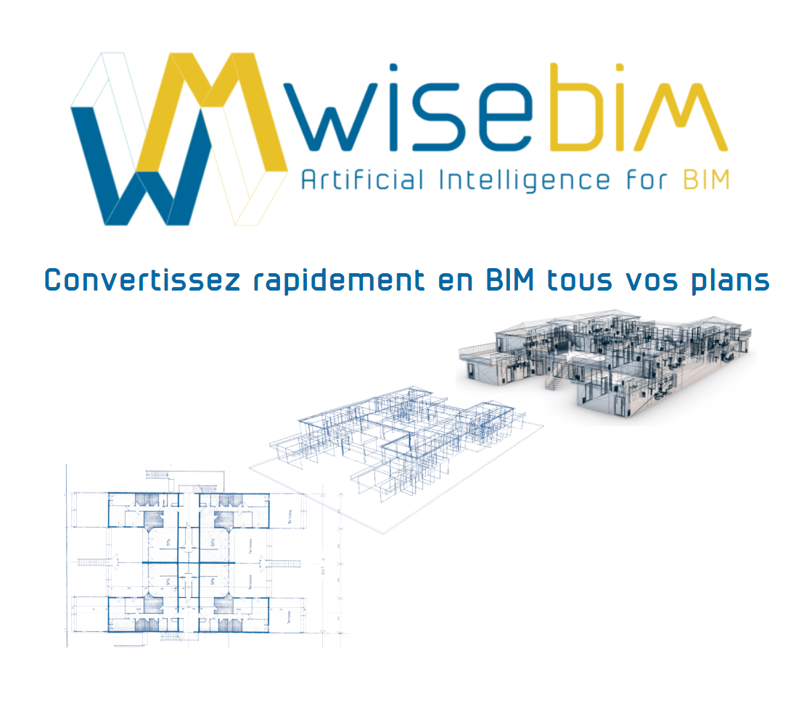
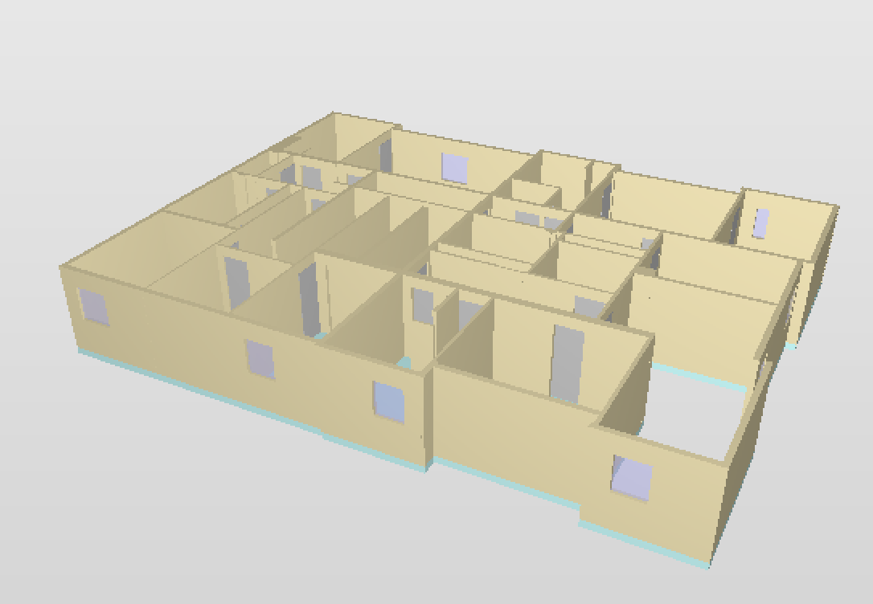
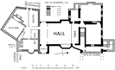

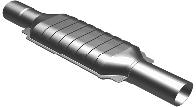

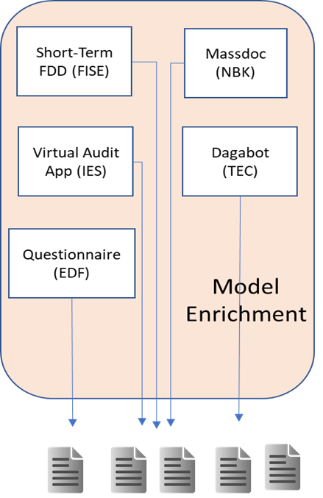



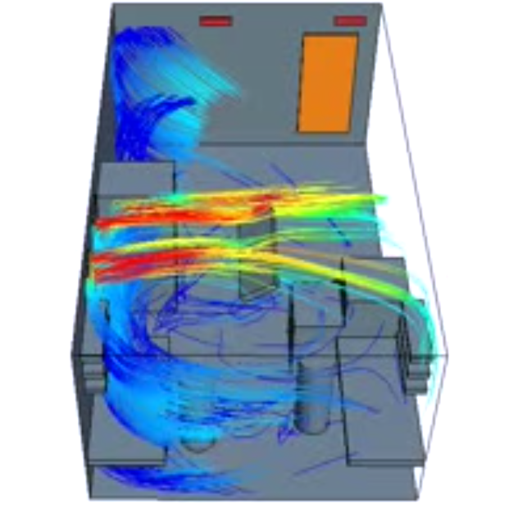
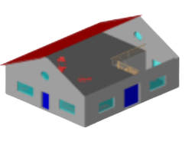


Alternative view
Matterport3D Scanner(CSTB)

Slide 4
BIM4REN WP4 context
Legend
WP6 One-Stop Access Platform
MS
Micro Service (non-BIM)
WP3/WP5 Tools and Services
DB
DB
Database (non-BIM)
MS
MS
MS
MS
MS
DB
BB
BIM Bot
WP4 Distributed BIM Repository
Maestro
BB
“orchestration”
BIM DB
BIM
Database
BB
BB
BB
BB
BIM DB
BIM DB
BIM DB
File-based: IFC-SPFF, ifcOWL/B4R-DM-JSON-LD
Direct access-based: SPARQL / GraphQL-LD
BIM Bots
implemented as “micro services” (OpenAPI)
deployed in Amazon Web Services (AWS) / CSTB KROQI platform

Slide 5
Scope Decisions /1
Basic data specifications (“data structures”):
bSI IFC version 2x3
B4R-DM (ontology) including:
W3C LBD Building Topology Ontology (BOT) ontology
CEN SML patterns, like for quantities
Scenario ontology
Journal of Changes (JoC) Ontology (separate from B4R-DM)
Two relevant underlying technologies:
ISO STEP technology (EXPRESS schema, SPFF data)
Standard interface: SPFF file import/export (upload/download)
W3C Linked Data (LD) technology (RDFS+OWL/SHACL, JSON-LD serialisation)
Standard interfaces:
JSON-LD import/export (upload/download)
SPARQL1.1 (optional GraphQL front-end)
Applied as defined by CEN SML
Two Data Servers involved
BIM Server (OSS: TUE/TNO) for 1.
Stardog v7 triple store for 2.
IFC data assumed to have non intersecting, mid-wall touching spaces with any shape representation (BB, BREP, extruded solids, …)

Slide 6
Scope Decisions /2
Extension tool (for energy aspects & renovation scenario’s) is CSTB’s LOD Lifter on LD side
Energy simulation approach in WP5, focus on IES VE dealing internally with secondary surfaces
Neutral geometry as bounding boxes (L-shape issues accepted)
Renovation extensions
Variants for renovation (TO-BE) scenarios with different measures, energy simulation results, KPIs etc. (no geometric changes involved!):
Adding insulation on walls
Replacing existing windows
New installation components (“products”) of heating systems like heat pumps for catalogues
State Model & User Model assumed to be not changed from AS-IS in TO-BE
Model checker work with RWTH SHACL-generated ontology (from OWL) transforming outputs as BCF-ontology instances (check)
veXML = gbXML (geometry) + physics (building/installations in B4R-DM)

Slide 7
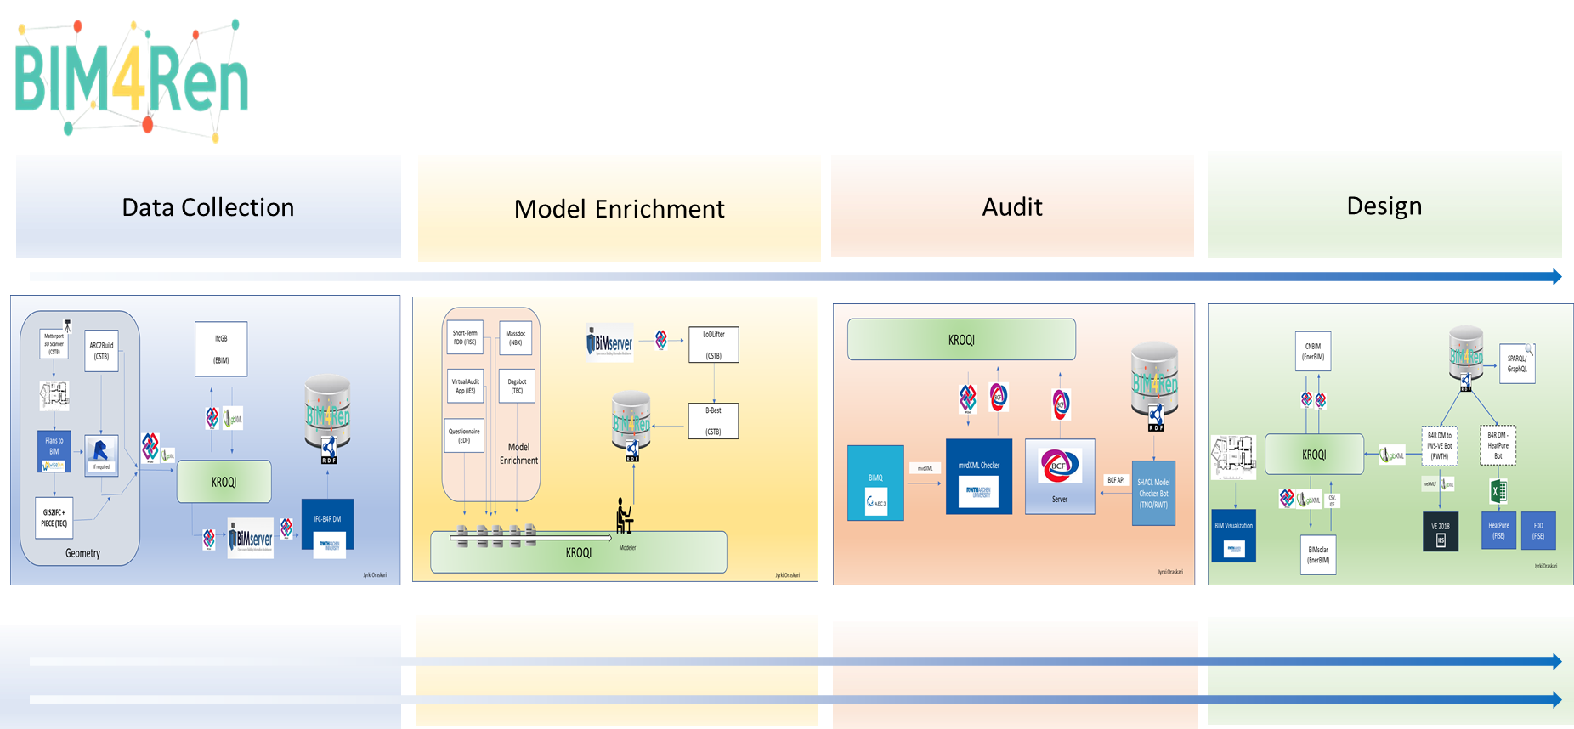
Renovation
Designer
To be added!
Orchestration

Slide 8
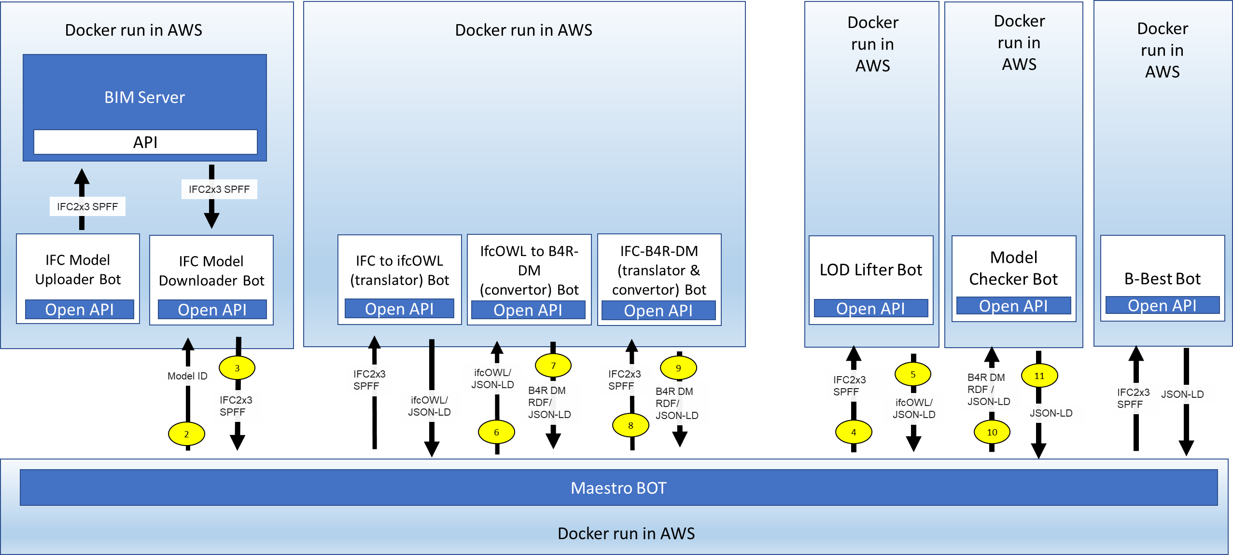





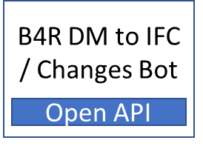
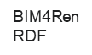
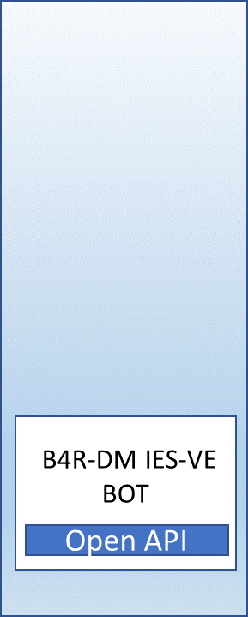


WP4 Architecture
BCF Server
BCF API
WP4 “BIM Repository”
WP3
BIMEO
AR2Build app
Autodesk
Revit
(incl. cleaning)
1
Matterport
3D
Scanner
WiseBIM
(2D > 3D)
2x3
Google
Earth
KML
Tecnalia parametric
GIS-2-IFC
B4R DM RDF
B4R DM/
JSON-LD
RDF Store
12
SPARQL
/GraphQL
interface
WP5
Energy
KPI
IES Cloud service
veXML/
gbXML
KROQI
EDMS
veXML/
gbXML
veXML/
gbXML
to
Model manipulation/simulation
MCA (WP7)
Presets
File folder

Slide 9
Views by Pierre to be integrated/harmonized

Slide 10



Workflow – Architecture – Geometry (#1)
BIMServer
Original GUIDs need to be preserved in the three different format
Geometry:
BIMServer: original IFC geometry
Triple Store: BB
gbXML: ~original???
LodLifter on ifcOwl/B4R (aligned)
IFC (Geometry)
SPFtoifcOwl
Triple Store
BIM4Ren
IFCtoGB
gbXML (Geometry)
To be added to earlier workflow!

Slide 11



Workflow – Architecture – Enrichment (#2)
To be added to earlier workflow!
BIMServer
SPF Updater
LodLifter
Triple Store
BIM4Ren
JoC
veGenerator
Catalogue
gbXML (Geometry)
Journal of changes:
File or DB+API?
Preference for DB+API
Specs on JoC (LodLifter capacities)
SPF Updater dev (update + BCF + report?)
Based on JoC? Or based on ifcOwl?
veGenerator
veXML

Slide 12
Workflow – Architecture – Reno Scenario (#3)
To be added to earlier workflow!
BIMServer
SPF Updater
LodLifter
Triple Store
BIM4Ren
RenoScen + JoC
veScenarioGenerator
Catalogue
Need update on BIMServer?
Not automatic – only on the final selected scenario
Store all scenarios in triple store as building models?
Need a ‘Renovation’ mode in LodLifter
Specs on RenoScen (from NBK+IES+TEC – validate with CSTB)
vsScenarioGenerator
Based on catalogue
Can be encapsulated in a series of Bot triggered by Maestro Bot (validation + ScenarioGen + IESVE + ScenCompare)
veXML
JSON IES

Slide 13
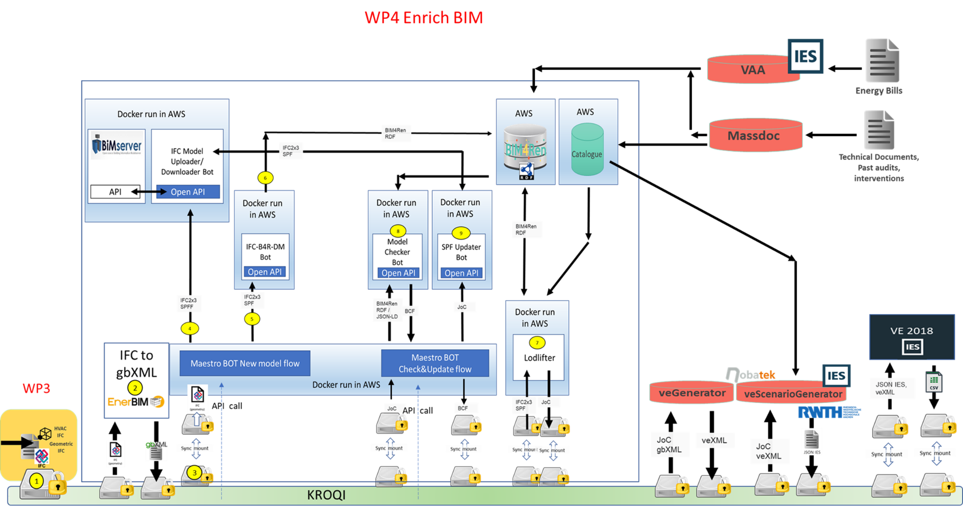
Integration by Jyrki /1

Slide 14
assumptions
The LoD lifter creates enriched IFC that IFC-B4R-DM converts into B4R DM RDF. There is no ifcOWL in between and so no need to convert ifcOWL into IFC
We will discusss the need of ifcOWL in the B4R DM later
veGenerator can use the enriched IFC and gbXML as input to create the veXML representation
JoC are saved in the RDF store, is the API solution is prefferred later, here only vScenarioGenerator uses it.
Maestro Bot can act as a KROQI service.
Maestro Bot is smart enough to understand when the Model Checker reports errors
I sketched also the possible use of LBDServer to visualize the data content, and the SHACL shape creating tool

Slide 15
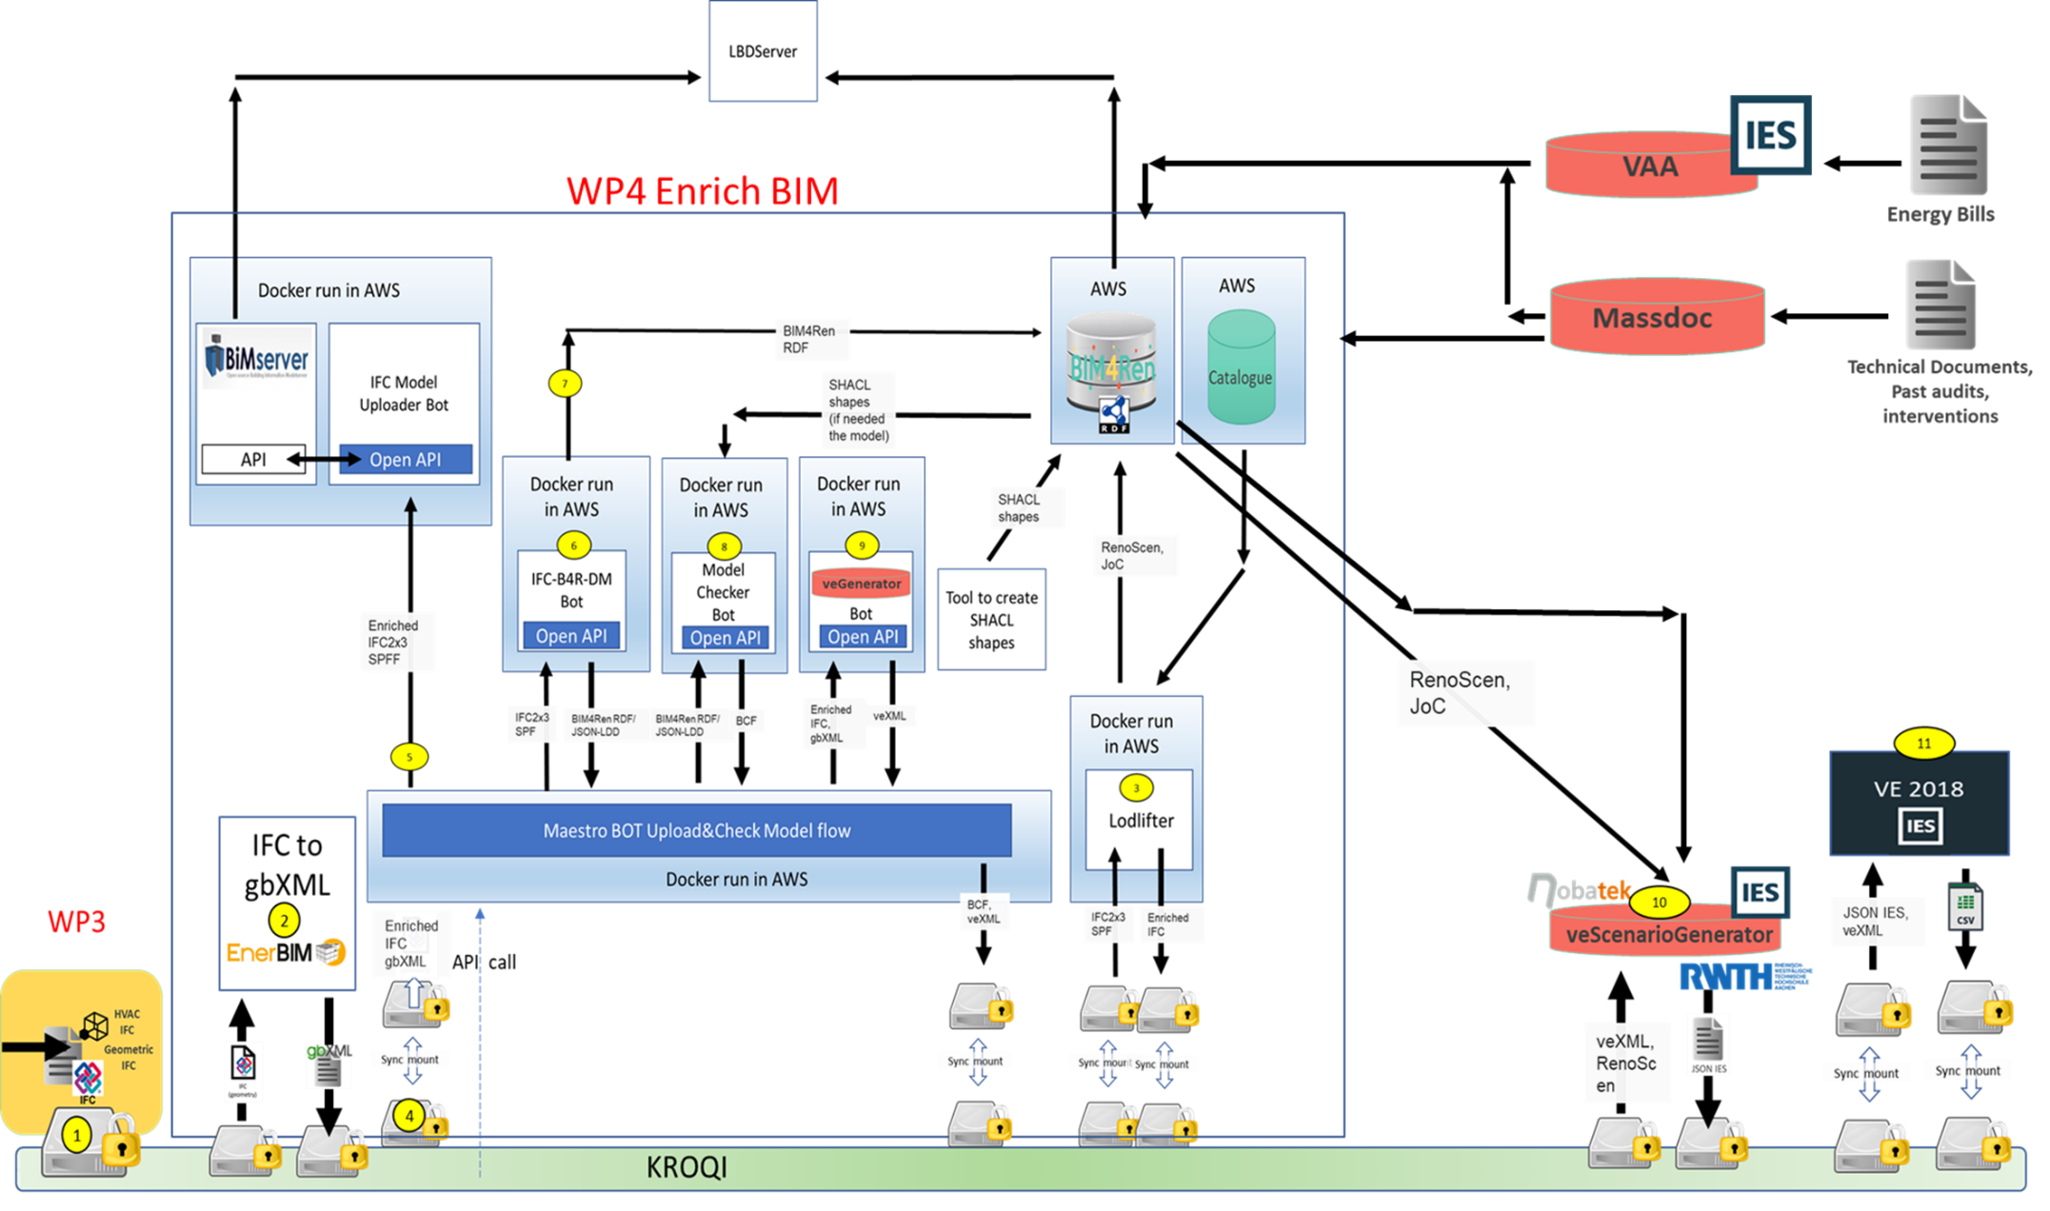

Slide 16
The bigger picture
BPMN workflows by AEC3 (Matthias)

Slide 17
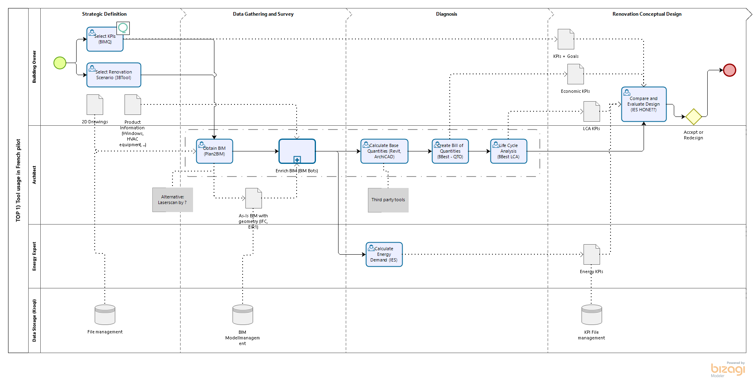
Overal workflow

Slide 18
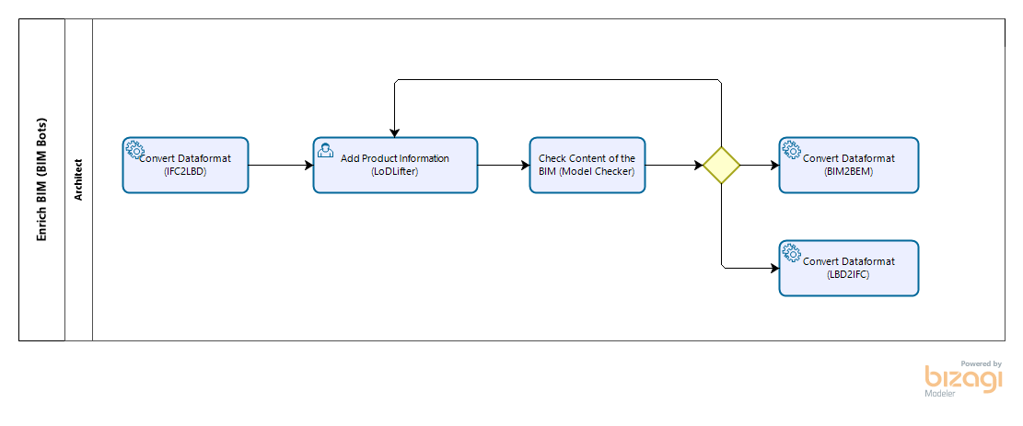
Example to be adapted!

Slide 19
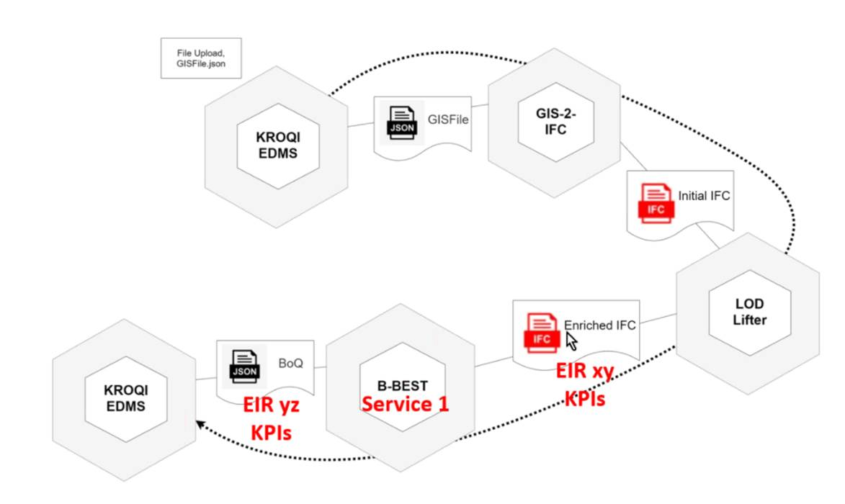
Alternative workflow view with B-BEST

Slide 20

WP 4 Planning - Team
PARTNER PM Contacts
TNO (NL) 18 Michel Böhms (WPL), Tim Dijkmans, Shang Jen Wang, Thomas Krijnen
CSTB (FR) 17 Bruno Fies, Nicolas Pastorelly, Nicolas Bus
RWTH (DE) 14 Jakob Beetz, Jyrki Oraskari, Madhumitha Senthilvel
NBK (FR) 4 Pierre Bourreau
AEC3 (DE) 2 Matthias Weise
EKO (UK) 2 Piers Larkman, Emre Yontem
EBIM (FR) 4 (link with ifc to gbXML translation/conversion)
TEC (SP) 4 (link with parametric GIS to IFC tool)
TERM (RO) 3 (link with HVAC modelling)

Slide 21
Planning /2 BIM4ren-WP4 email/telcon list for key partners
michel.bohms@tno.nl
tim.dijkmans@tno.nl
mail@thomaskrijnen.com
shang_jen.wang@tno.nl
bruno.fies@cstb.fr
nicolas.pastorelly@cstb.fr
nicolas.bus@cstb.fr
j.beetz@caad.arch.rwth-aachen.de
Jyrki.Oraskari@dc.rwth-aachen.de
senthilvel@caad.arch.rwth-aachen.de
pbourreau@nobatek.inef4.com
mw@aec3.de
emre.yontem@ekodenge.com
piers.larkman@ekodenge.com

Slide 22
TASKS
T4.1 BIMServer extensions (TNO & RWTH, D4.1 & D4.2)
Develop IFC to LD transformers as BIM bots [RWTH/Jyrki]
Actualise invocation & I/O BIMserver bot according to WP2 spec + arrays/packages [TNO/Ruben, done]
Deploy in AWS/KROQI, as docker container involving Open API [RWTH/Jyrki]
Define/implement B4R-DM ontology [NBK/Pierre]
T4.2 Preprocessing
Validation >>> Checker Bot (TNO, D4.3)
Checker to be developed as BIM Bot [TNO/Thomas]
Deploy in AWS/KROQI as docker container involving Open API [TNO/Thomas]
Enhancer (CSTB, D4.4)
LOD Lifter development (for AS-IS) [CSTB/Bruno]
T4.3 Architecture, Workflow & Maestro Bot (TNO, D4.5)
Architecture/Workflow [TNO/Michel]
Develop Maestro BIM Bot [TNO/Shang Jen]
Deploy in AWS/KROQI as docker container involving YAML [TNO/Shang Jen]
T4.4 Extension/Renovation Designer incl. object catalogues (CSTB, D4.6+D4.7)
Renovation Designer developed and encapsulated as wrapper BIM Bot (for TO-BEs), including a [CSTB/Bruno]
Deploy in AWS/KROQI (LOD Lifter incl.) as docker container involving Open API [CSTB/Bruno]

Slide 23
Schedule & status
WP4 end: March 2021
D4.1 is due September 2020 (BIM server update - TNO) DONE
D4.4 is due November 2020 (Model enhancer / LOD Lifter - CSTB) UNDER CONSTRUCTION
D4.5 is due November 2020 (Maestro bot - TNO) UNDER CONSTRUCTION
D4.2 is due March 2021 (BIM4REN repository - RWTH)
D4.6 is due January 2021 (Object catalog online service - CSTB)
D4.3 is due March 2021 (Checker - TNO)
D4.7 is due March 2021 (public BIM renovation designer tool - CSTB)

Slide 24
Issues discussed recently

Slide 25
Shape Representation
Discussions:
We will assume spaces in the originating IFC step files (at least one global space)
We will assume bounding boxes as explicit shape representation of the spaces (centerlines of walls, not overlapping, touching not floating)
CSTB generates the bounding boxes from the IFC step files with IfcSpace’s (having various shape reps incl. extruded solids, breps etc.) into ifcOWL data
We know and accept the accuracy issues (like for L-shapes): we compare as-is and to-be primarily, we do not necessarily validate with reality…
Jyrki can take those into account when converting to BIM4Ren-DM (no need for separate/parallel IFC-to-B4R-DM transformer)
He then generate B4R-DM data according to a BB-geometry sub-ontology to be decided (separate issue)
Splitting boxes/surfaces for secondary surfaces can be assumed part of energy analysis preprocessing
Jyrki: sorry I did not get your point on the point cloud mathematics wrt orientation. Please add.
ACTIONS:
Have a call CSTB/TNO/RWTH/NBK to compare the modelling of the geometry in both CSTB (LoDLifter), IFCtoBOT converter
Decide on which converter
Decide on format in ontology (Jyrki’s based on WKT GeoSPARQL format)

Slide 26
gbXML vs veXML
Discussions:
veXML = gbXML+ ( “customized gbXML”) where the + = physics
A BIM Bot translator will be developed by Jyrki to generate veXML from the BB-geometry and extended physics data in B4R-DM
Still not fully clear how EnerBIM IFC2GBXML tool can/will play role here. Since geometry part of veXML==gbXML, reuse seems smart. Tool also operates from IFC not B4R-DM – Pierre: view is clear to me. We can discuss it.
Maybe translator has 2 parallel lines (enerbim from IFC for geometry) and translator from B4R-DM (for physics) and then merge results? – Yes, see below
Could work since LOLL does not touch geometry in between at ifcOWL.
Extreme minimum would be: “no physics” (all default) but we want to do better, partly default, partly from B4R-model data: all LODL-enriched properties will be in veXML translator
ACTIONS:
IES: send specifications to know which paramter needed in the veXML
NBK: identify those in B4R. Design APIs or GraphQL-LD
RWTH: develop BOT: inputs could be gbXML + list of veXML parameters (or IFC or B4R paramaters) required . Output veXML.
EBIM/NBK/CSTB/RWTH: Need ID mappings: IFC GUID – B4R URL – gbXML IDs

Slide 27
BIM4Ren data model
Discussions:
Existing model on GitLab
Pierre is working on a dereferenceable version of BIM4R-DM in OWL on B4R website & documentation
We can generate closed world SHACL variant (restrictions>shapes) in tools like Top Braid Composer (TBC) or RWTH/Madhu PHD tool
This SHACL is then input to Model Checker bot next to the actual model for data verification
Using existing open source model checker (TQ), https://github.com/TopQuadrant/shacl
Output of this tool to be extended to Journal of Changes (JoC) data according to JoC subontology in B4R-DM.
mvdXML-based IFC-side model checking could be still relevant (TBD). Here also properties can be checked (not just right IFC subset/configuration). Checking power compared to SHACL is unclear.
ACTIONS:
NBK: publish ontology + documentation
NBK/RWTH/TNO: have a call on SHACL generation (Madhu’s work)
Step by step, we’ll need to define validators for every tool with BIM inputs. Those could be mvdXML or SHACL (preference for the second one)

Slide 28
Backlink LD to IFC
Discussions:
No geometry changes assumed, only properties (added or values changed)
IFC updater based on JoC-data (possible because link to original GUIDs available)
Works for as-is extensions and final chosen to-be extension (intervention/measure)
PIERRE: unclear to me whether the B4R to IFCowl mapping can be done or not. Pretty sure it is easy on everything but properties. Still can be done on properties (BSDD references are used in the B4R model)
ACTIONS:
NBK/RWTH/TNO/CSTB: have a call on the topic to better check how to implement
TNO/CSTB: identify requirements on JoC
CSTB: generate JoC
RWTH: BOT to incorporate changes

Slide 29
Key Performance Indicators (KPIs)
Discussions:
On relevant for project data at higher level workflows (even beyond B4R-DM database)
Compare WP4: no KPI, KPI come(s) from final IES analysis
ACTIONS:
EKO (or whoever in WP6): design Project Information Model and associated data store (technology of your choice). Must include KPIs and APIs to access them along the project.

Slide 30
Architecture/Workflow
Discussions:
Experiment: how to best position WP4 data-oriented workflow in the overall end-user workflows (all in one box now): align!
When above all agreed and consolidated: adapt WP4 architecture & workflow
ACTIONS:
Keep the good work ☺

Slide 31
Implementation sheets by Jyrki

Slide 32
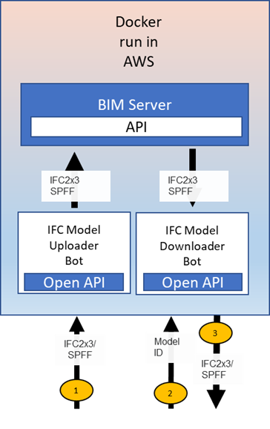
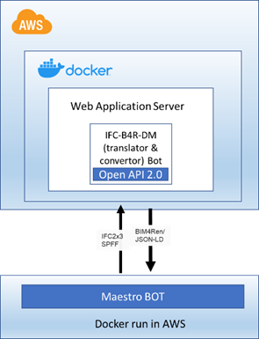
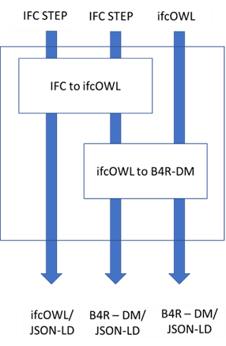
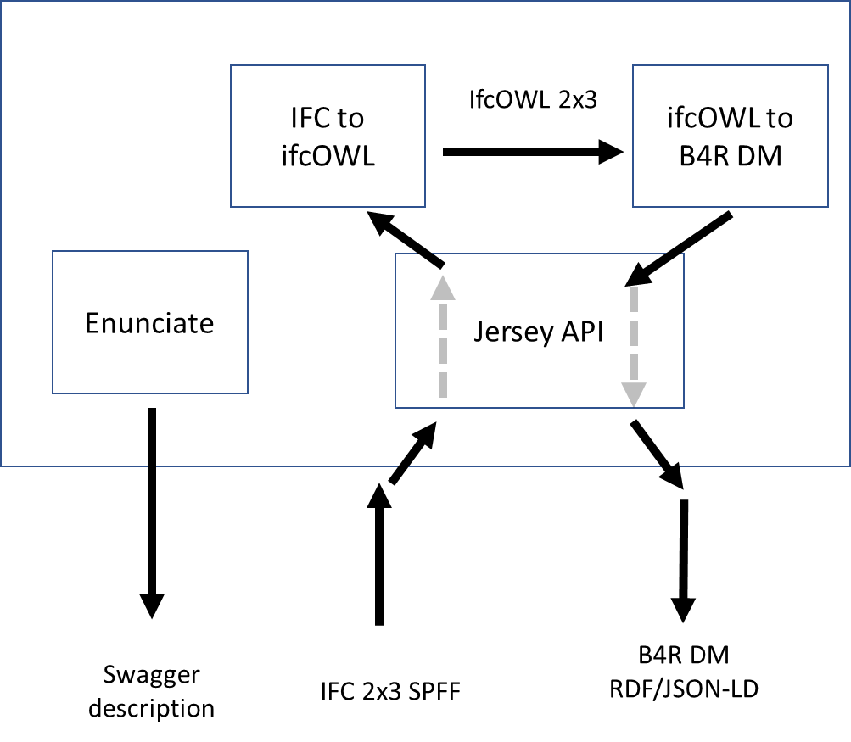

Slide 33
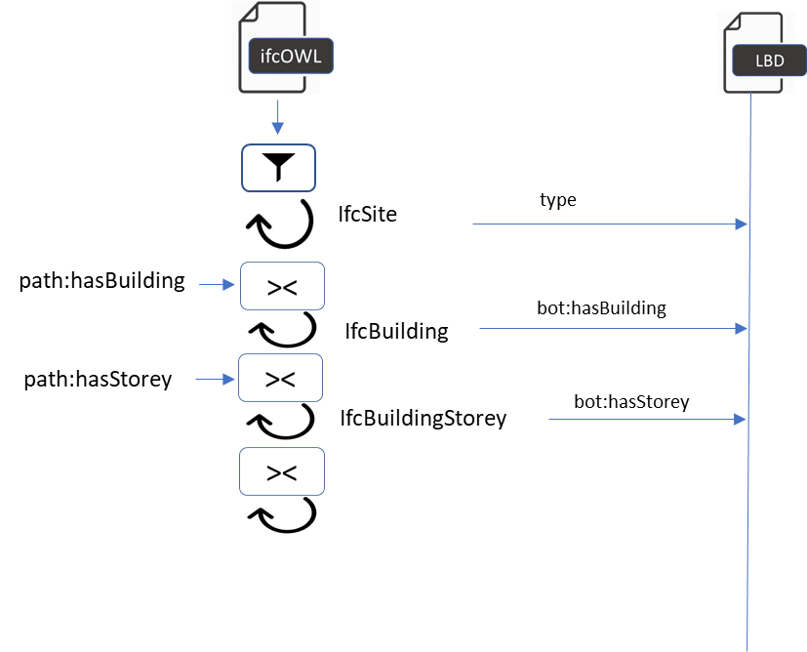

Slide 34
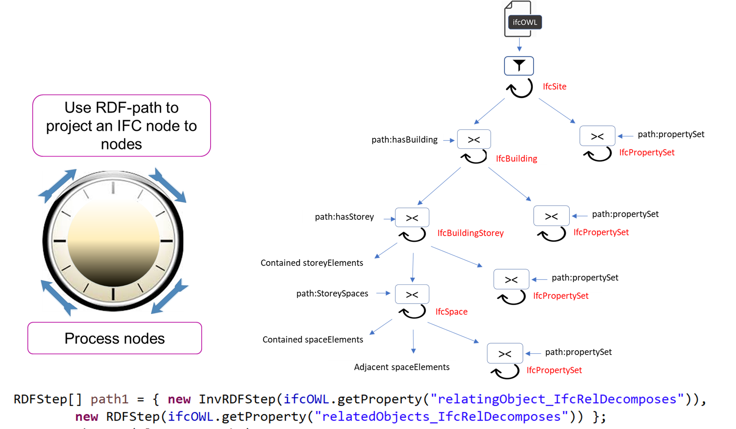

Slide 35
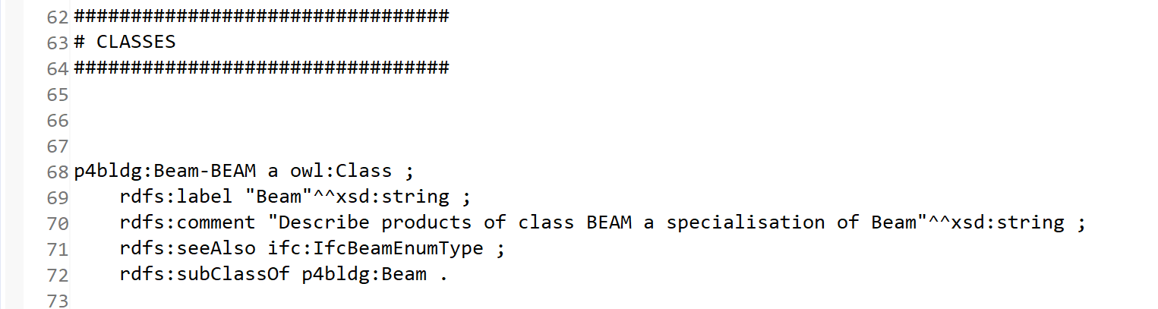
IFC file
IFC OWL
ontology reason
IFC header reader
Version
Subclasses
Conversion rules

Slide 36
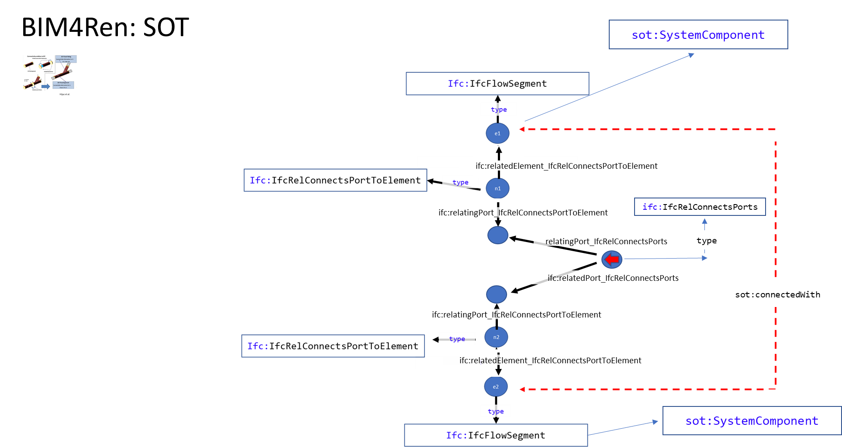

Slide 37
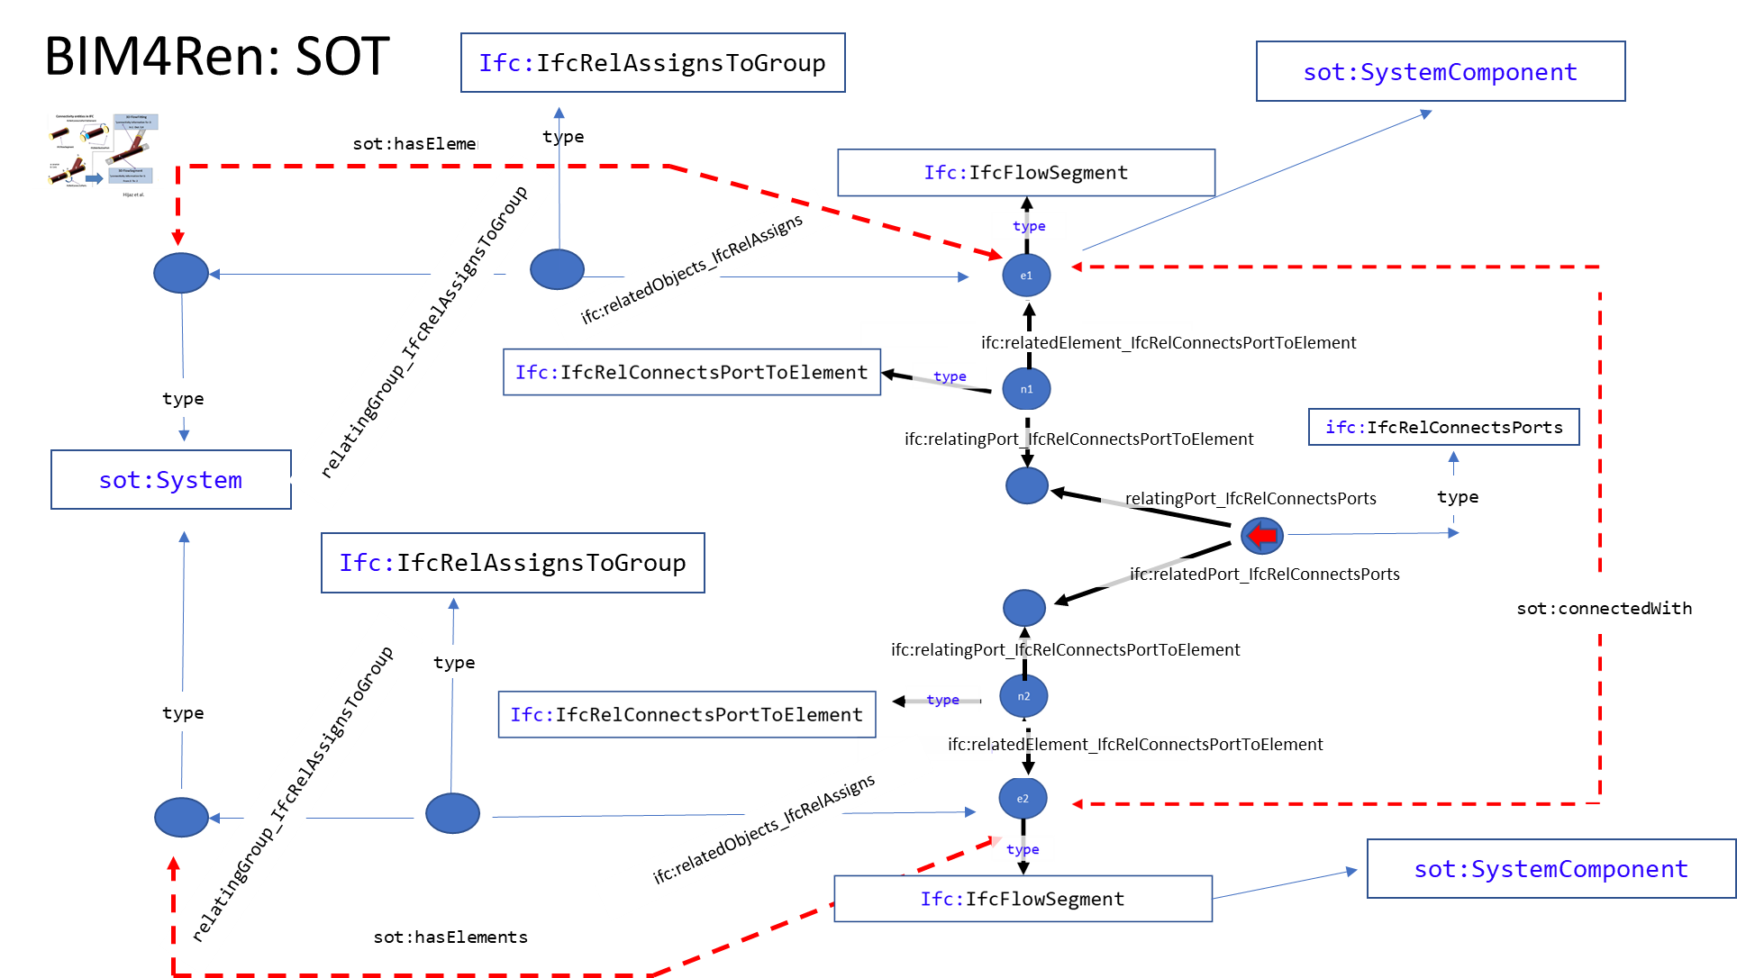

Slide 38
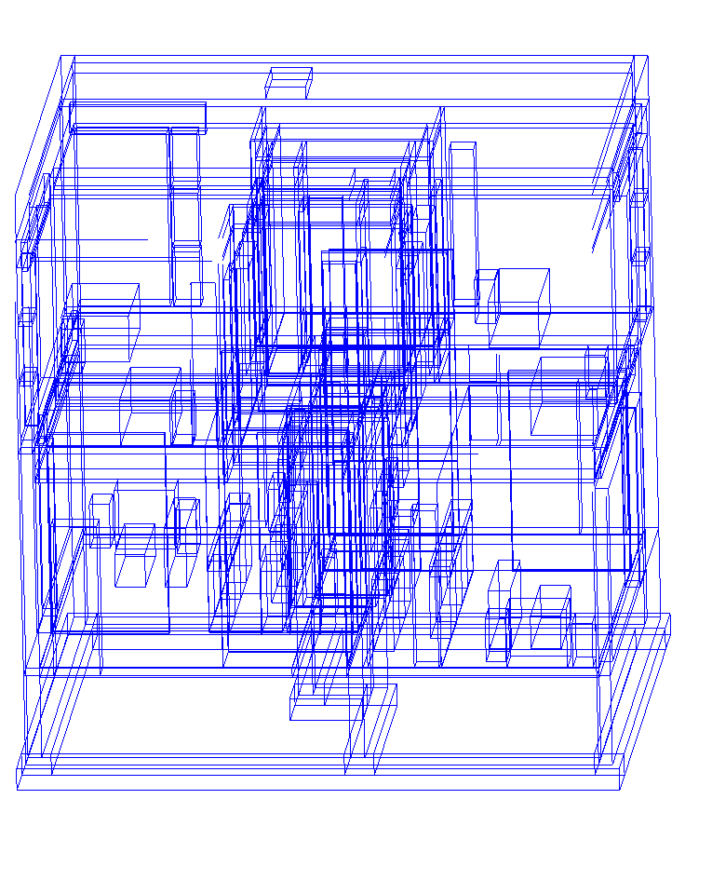
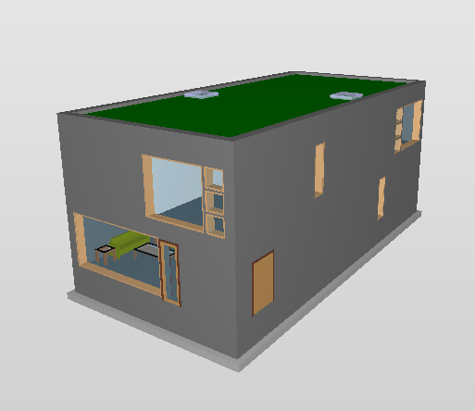

Slide 39
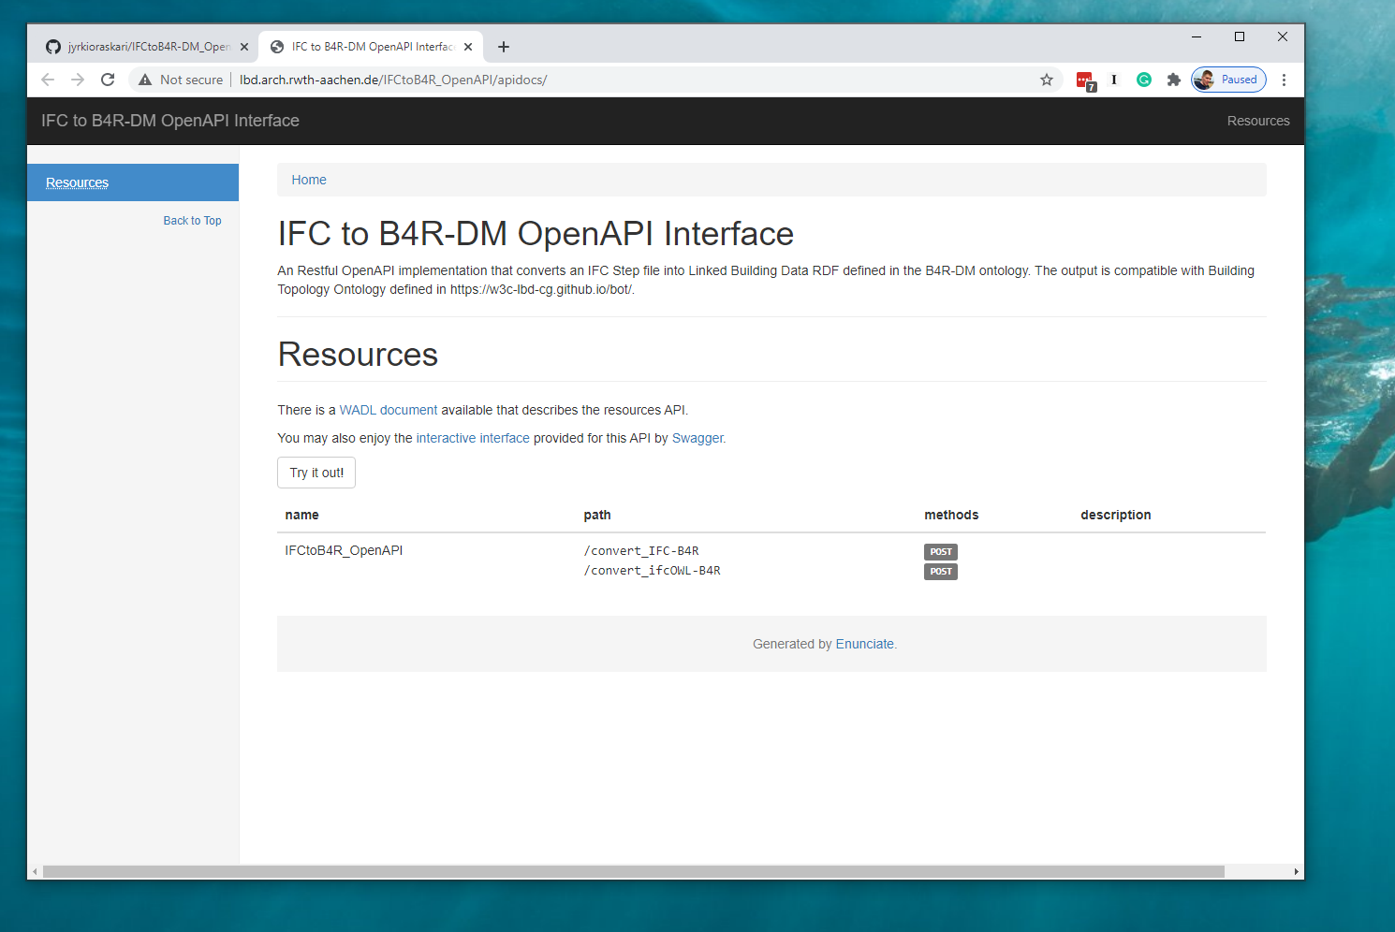

Slide 40
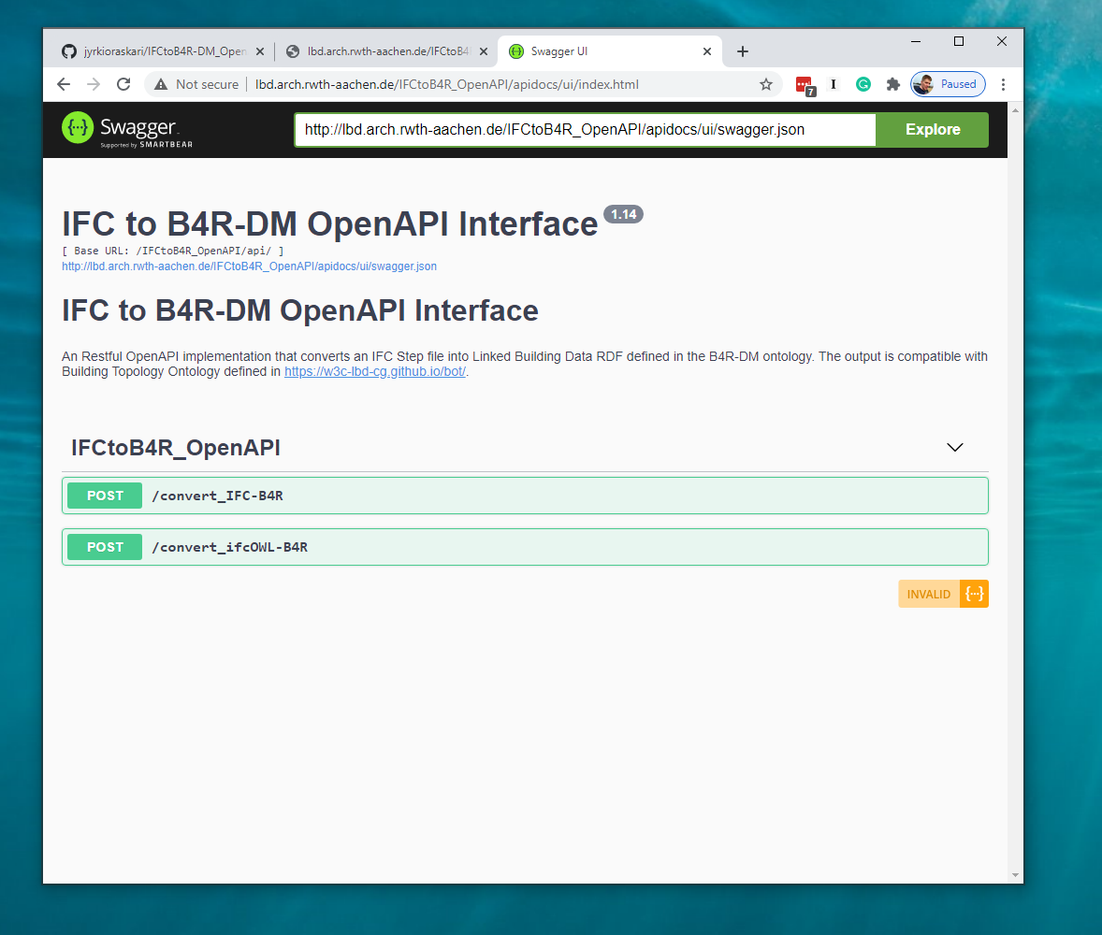

Slide 41
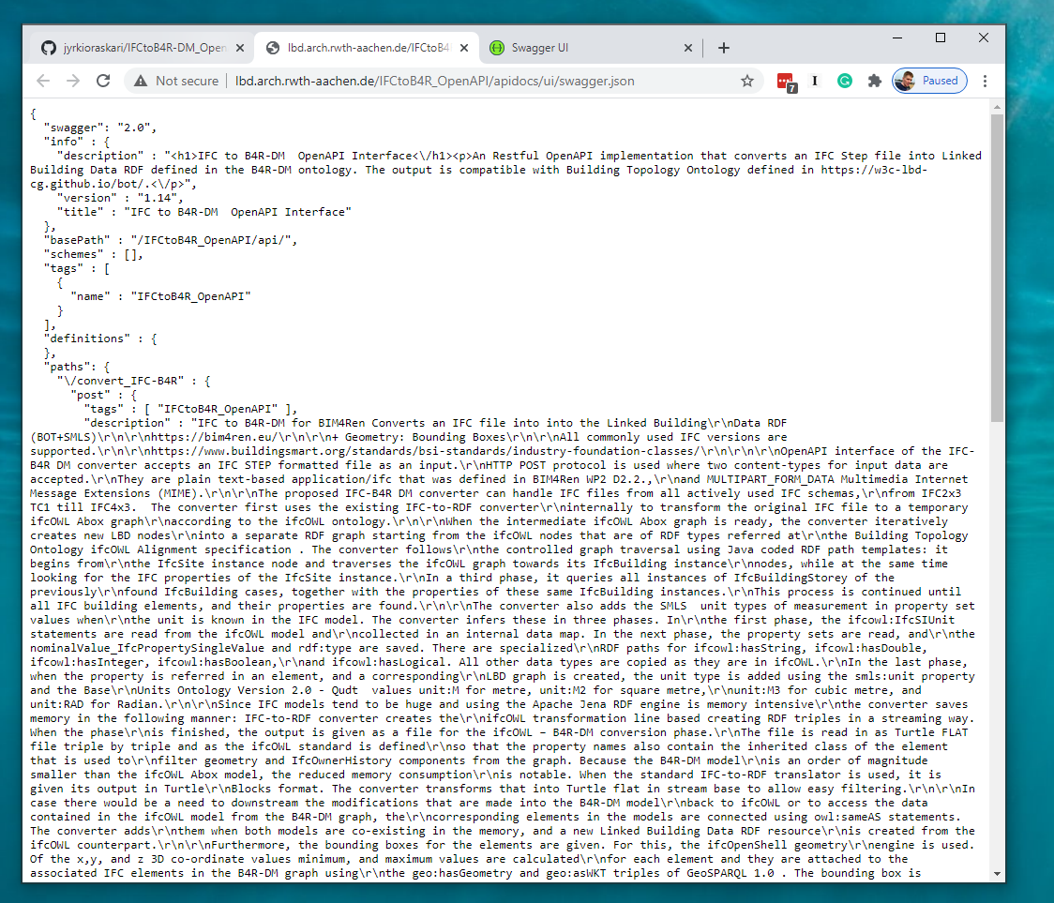

Slide 42
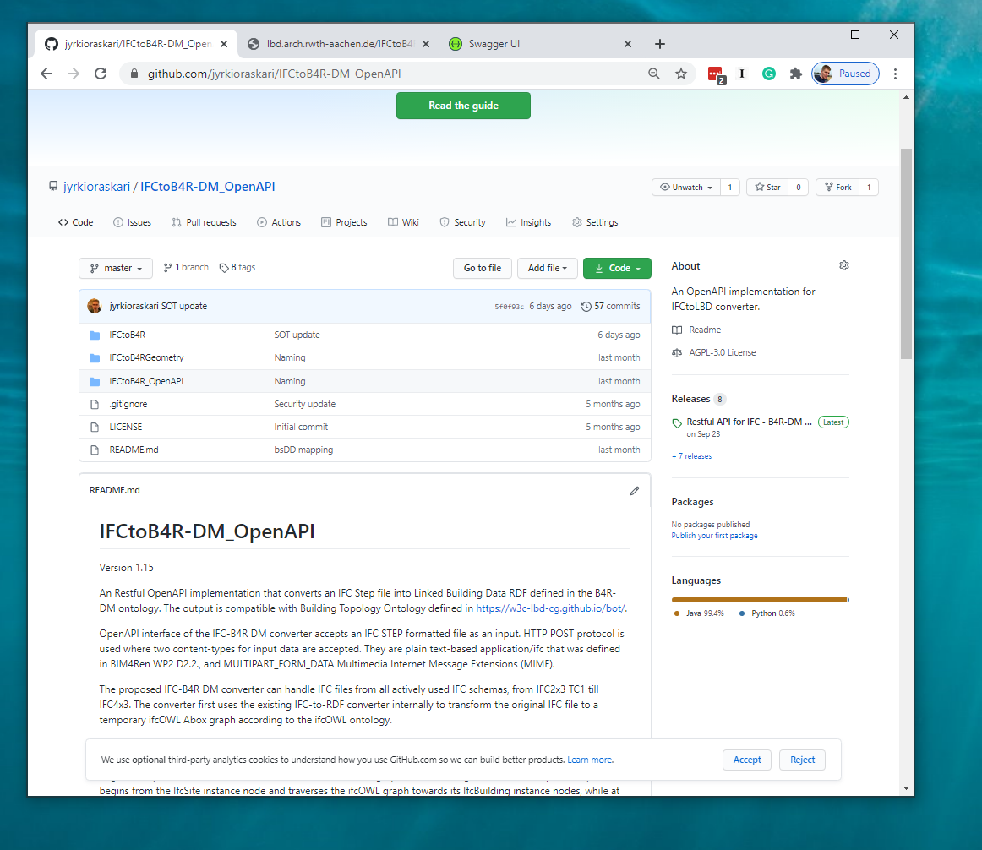

Slide 43
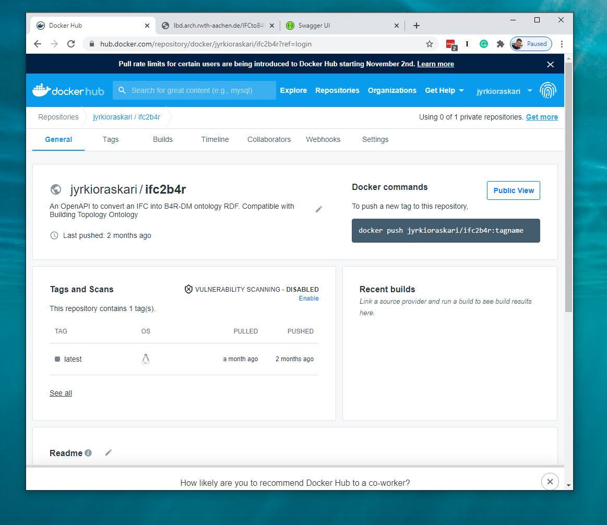

Slide 44
Thank you for your attention
Take a look:
TNO.NL/TNO-INSIGHTS

